Slide 1








Introduction to Electronic Engineering
The Invisible Power Behind Modern Technology
Speaker: Daniel
Date: Nov 18, 2025

Slide 2







About Me
My name is Daniel, and I'm currently studying Electronic Engineering.
Many people think I'm a computer science student because of the software projects I've built.
The Truth About My Major
Despite my major, I've developed:
A cinema broadcasting system
While my projects might suggest computer science, my real passion lies in Electronic Engineering.
An airport announcement generator
Today, I'll share with you why this field is both mysterious and omnipresent in our modern world.
A personal website
An online aviation chart viewer
Let's explore what Electronic Engineering really is...

Slide 3
















What is Electronic Engineering?
Electronic engineering is the study of how to design, build, and improve electronic systems — from small circuits to huge communication networks.
Electric Signals
Signal Processing
System Improvement
We learn how electric signals move and how to control their behavior
We study how to process and manipulate signals for various applications
We focus on making devices smarter, faster, and more efficient
Small Circuits
Large Networks

Slide 4









Core Focus Areas
Signal Movement
Signal Processing
We study how electric signals travel through various mediums and components, understanding the fundamental principles that govern electrical phenomena.
We learn how to manipulate and transform signals to extract useful information, including filtering, modulation, and enhancement techniques.
Device Optimization
System Integration
We work on making electronic devices smarter, faster, and more efficient through innovative design and advanced manufacturing techniques.
We develop expertise in combining individual components into cohesive systems for specific applications, from small circuits to vast communication networks.
These core areas form the foundation of all electronic engineering disciplines.

Slide 5













Application 1: PCB & Basic Electronics
What are PCBs?
Printed Circuit Boards are the "skeleton" of all electronic devices.
PCB to PCBA
They provide the foundation and structure that connects all electronic components together.
PCB
Components
PCBA
Circuit Board
Electronic Parts
Circuit Board Assembly
From smartphones to industrial robots
Without PCBs, modern electronics simply wouldn't exist!
PCBs are the foundation of all modern electronic devices
Next: Understanding PCBA

Slide 6


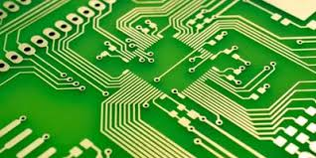
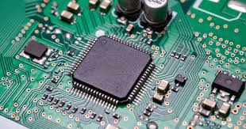






PCB to PCBA
PCB
PCBA
(Printed Circuit Board)
(Printed Circuit Board Assembly)
PCB is like the skeleton of electronic devices, providing the structure and connections.
PCBA is what happens when electronic components are mounted on the PCB, creating a functional electronic device ready for use.

Slide 7
















Application 2: Communication Systems
One of the most fascinating areas in electronic engineering is communication systems. These systems enable the wireless transmission of information across vast distances.
Wi-Fi
5G
Bluetooth
Enables wireless networking connectivity for devices over short to medium distances
The latest mobile network technology providing ultra-fast data transmission and low latency
Short-range wireless technology for connecting devices like headphones, speakers, and phones
GPS
Satellites
Aviation Systems
Global Positioning System that uses satellites to determine precise location information
Orbital devices that relay signals for communication, navigation, and Earth observation
Radio and radar systems built by electronic engineers that pilots rely on for safe flight
These systems are based on the same principles we study — signal transmission, modulation, and filtering.

Slide 8
















Signal Transmission Principles
Communication systems rely on the fundamental principles of signal transmission, modulation, and filtering to send and receive information across various technologies.
Signal Transmission
Modulation
Filtering
The process of sending data from one point to another through a medium. In electronic engineering, this involves converting information into electrical signals.
The process of varying one signal to represent information. Different techniques (AM, FM, digital) allow efficient transmission over various channels.
The process of removing unwanted noise from signals. Filters allow specific frequency ranges to pass while blocking others.
Real-world Applications:
Wi-Fi
5G
Bluetooth
Satellites
Pilot Radio/Radar

Slide 9









Application 3: Advanced Technologies
Electronic engineering drives cutting-edge technologies that are transforming our world:
Autonomous Driving
Artificial Intelligence
Sensors collect visual and radar data
Powerful hardware processes massive data
Electronic circuits process information
Specialized chips accelerate AI calculations
Make driving decisions in real-time
Processors and servers power AI models
Electronic engineering enables the impossible become possible

Slide 10
















Self-Driving Car Electronics
Sensors Collect Data
Electronic Processing
Cameras
Radar
How Electronics Make Decisions
Capture visual data for lane detection, traffic signs, and object recognition
Measure distance to objects and detect their speed through radio waves
Electronic circuits process data from sensors in real-time
Signal processing filters noise from raw sensor data
Analog-to-digital converters transform physical signals into digital data
LiDAR
IMU
Creates detailed 3D maps of surroundings using laser pulses
Inertial measurement unit tracks acceleration and rotation
Driving Decisions
The processed data feeds into the car's control systems:
Steering
Braking
Speed Control

Slide 11

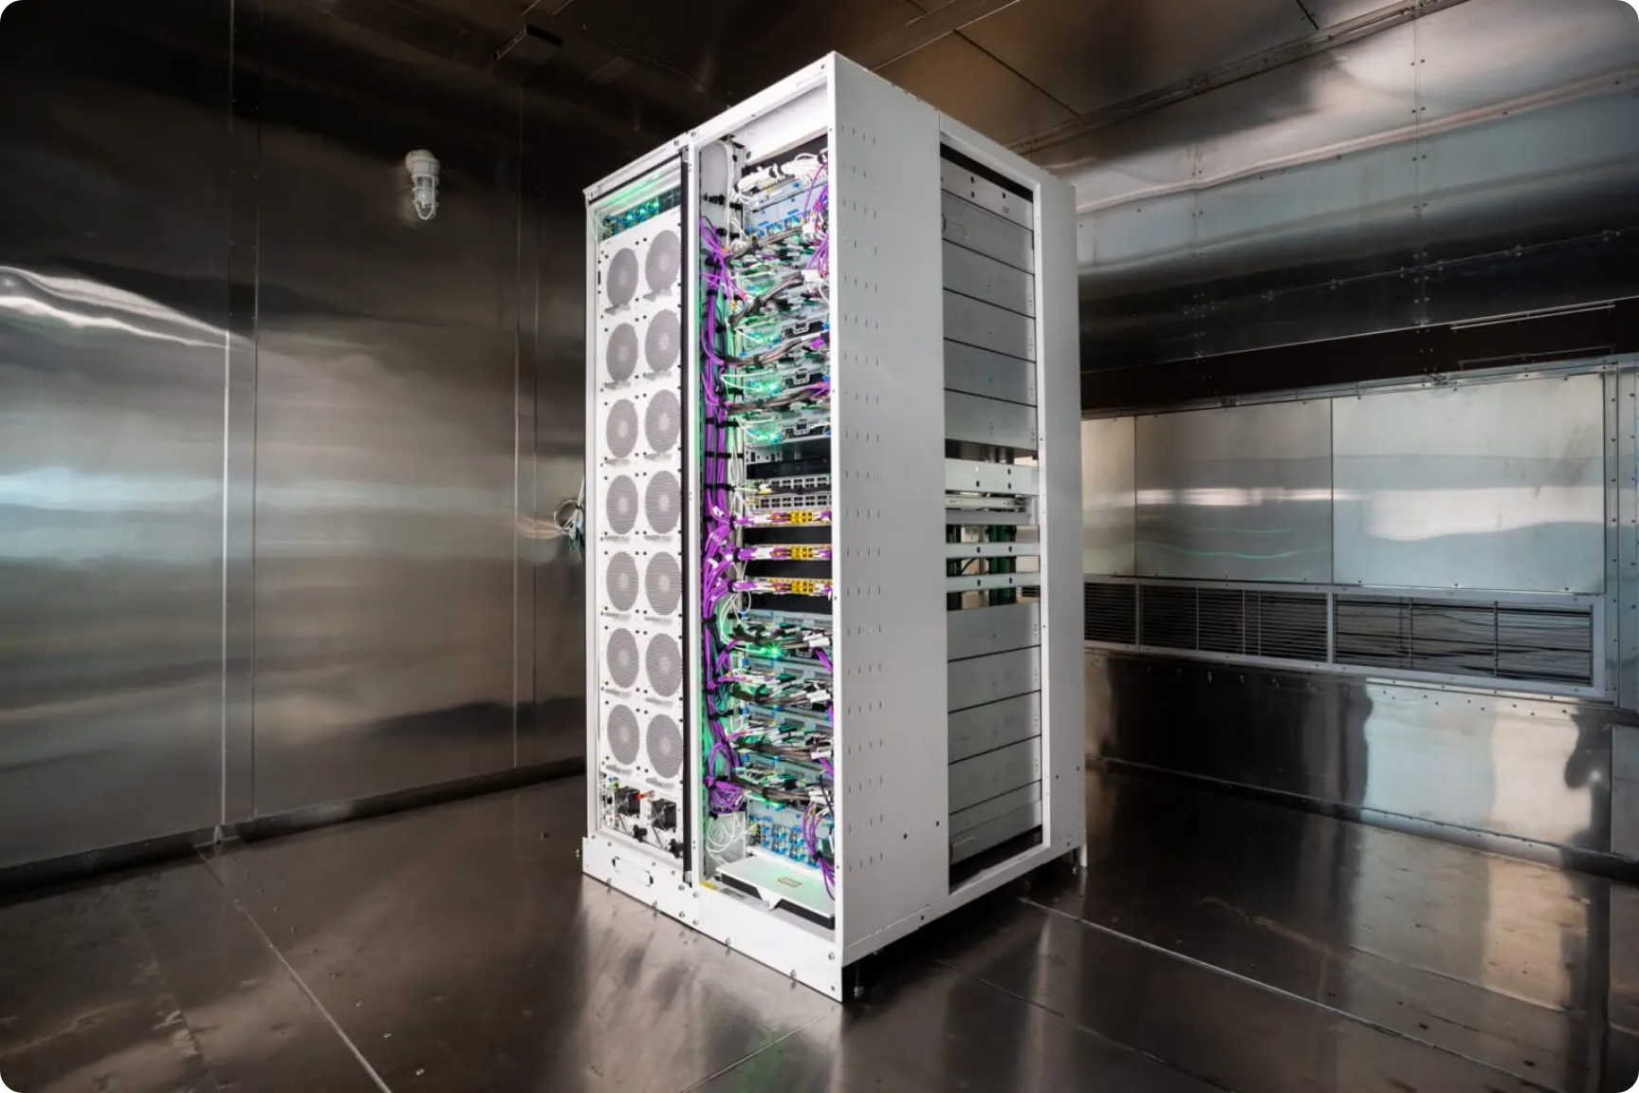




AI Hardware Infrastructure
Large AI models like chatbots and image generators rely on electronic hardware designed by electronic engineers.
Chips & Processors
Specialized hardware for AI computation
Servers & Data Centers
Powerful infrastructure for AI training
High-Speed Networks
Connect AI components globally
Electronic engineers design the hardware that powers today's AI revolution

Slide 12
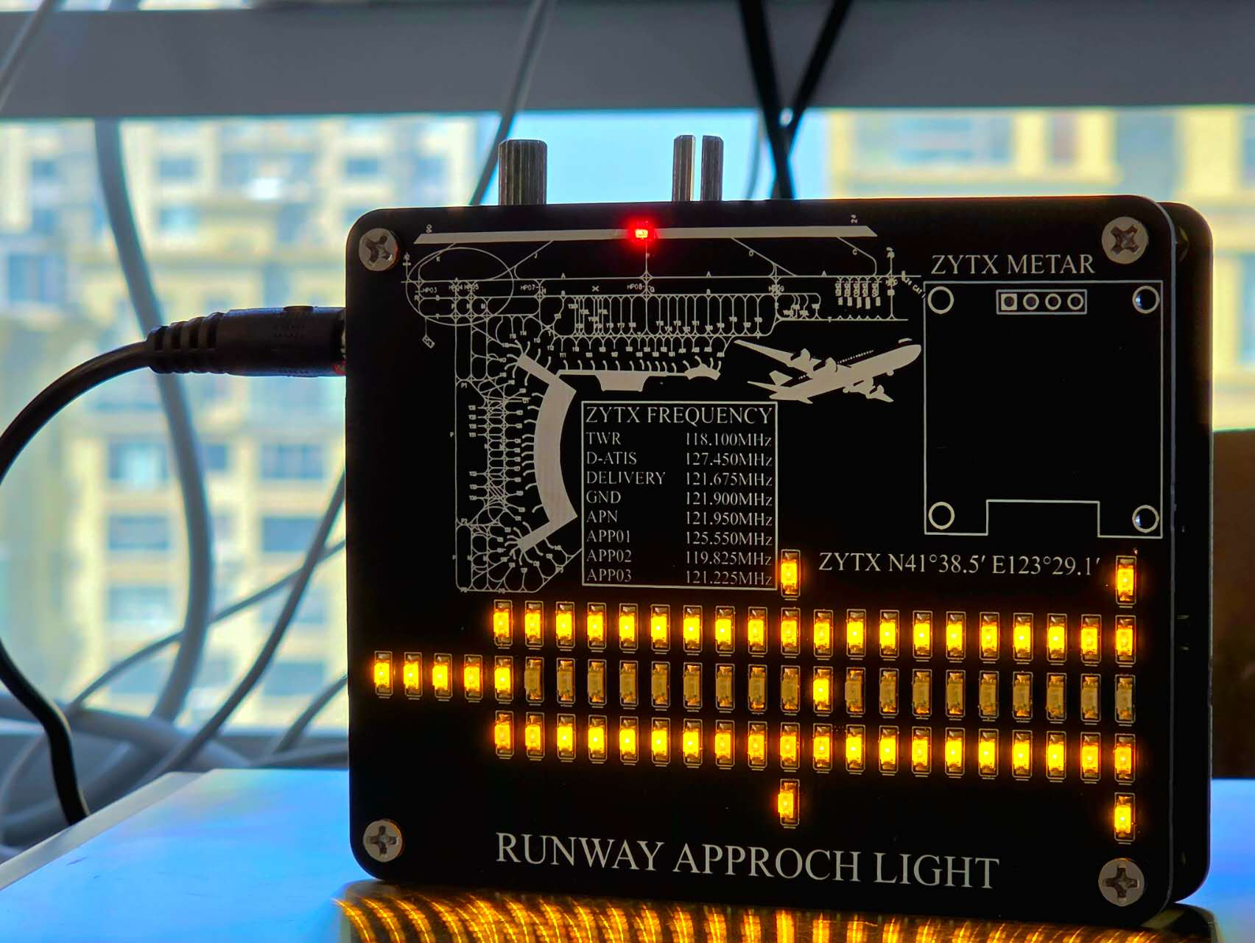




My Project: Runway Approach Light
I created a decorative desk lamp inspired by airport runway lights.
Connects to the internet to fetch real-time weather data
Changes color based on actual visibility and weather conditions
Provides a unique blend of aviation hobby and engineering skills
"As both a flight enthusiast and an electronics student, this was a fun way to combine my hobby and my major."
My airport runway approach light desk model

Slide 13
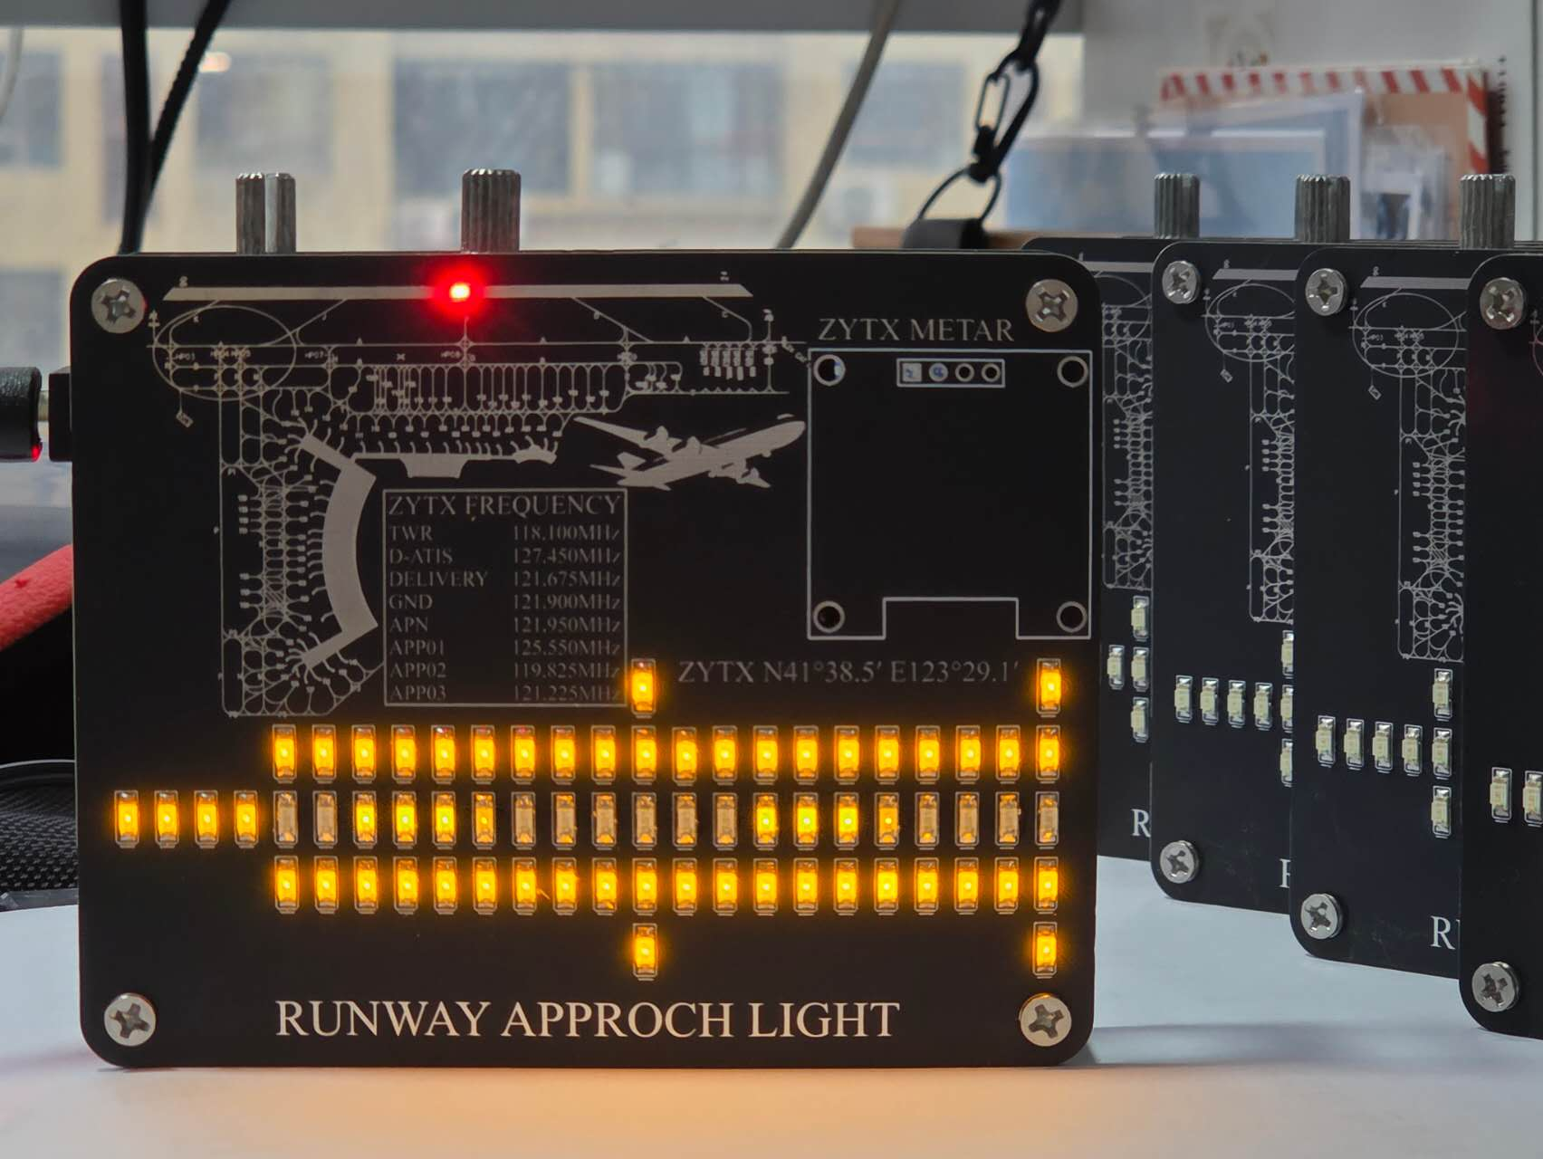












Smart Functionality
How It Works
Connects to Internet
Downloads METAR Data
Changes Color
Real-time Weather Data
Uses METAR data to get actual weather conditions
Visibility Awareness
Changes based on actual visibility at the airport
My runway approach light model
Airport Selection
This project combines my passion for aviation with my electronics studies. The desk lamp is not just decorative—it's a functional weather-aware lighting system.
Can be programmed for any airport with METAR service
14/23

Slide 14



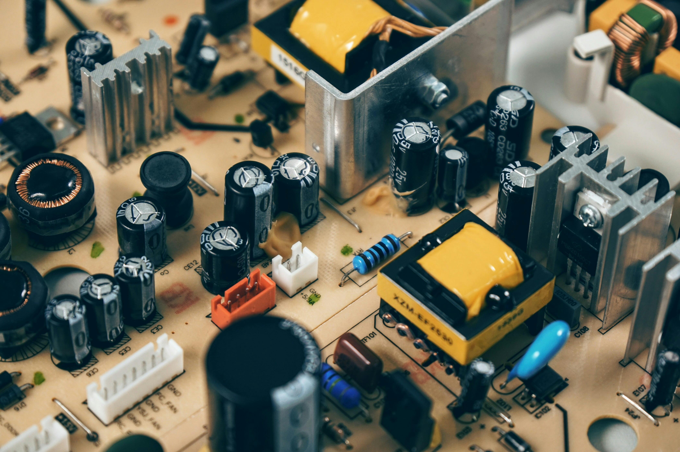

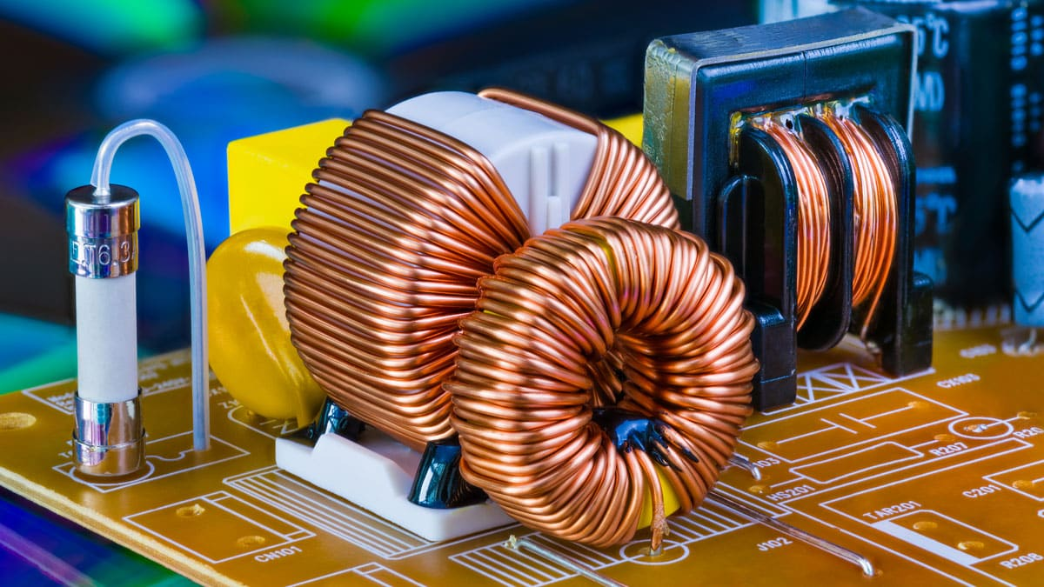





Core Theories: Basic Components
Everything in electronic engineering starts with understanding these fundamental components and their properties.
Capacitor
Inductor
Allows AC to pass, blocks DC ("AC through, DC block")
Blocks AC, allows DC ("DC through, AC block")
Stores and releases electrical energy
Creates magnetic fields when current flows
Used in power supply filtering
Used in signal processing and filtering
When Combined:
When combined, capacitors and inductors create filter circuits that remove unwanted noise and signals.
Filters

Slide 15






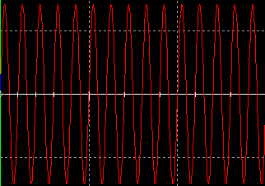


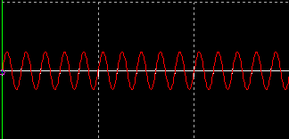




Capacitors & Inductors: Opposite Functions
Capacitor
Inductor
AC through, DC block
DC through, AC block
Allows alternating current (AC) to pass
Allows direct current (DC) to pass
Blocks alternating current (AC)
Symbol
Blocks direct current (DC)
Symbol
These fundamental components are essential to electronic circuit design, enabling filters and signal processing.

Slide 16





Real-Life Example: Power Supplies
RC Low-Pass Filter Circuit
RC low-pass filters are widely used in DC-DC power supplies to:
Smooth the voltage output from ripple
Reduce high-frequency noise
Improve power supply stability
Input
Output
Everyday Application
Even your phone charger uses this principle! It contains an RC filter to provide clean, stable power to your device.
How It Works
The capacitor charges and discharges to smooth voltage fluctuations.
The inductor resists changes in current, filtering out high-frequency noise.
19/23

Slide 17
















Conclusion: Everyday Electronics
Electronic engineering principles are all around us, making modern conveniences possible in our daily lives.
Phone Chargers
Wi-Fi Routers
Smart Home Devices
Uses RC low-pass filters to smooth voltage output and reduce high-frequency noise, ensuring safe charging.
Employs signal transmission and modulation principles to wirelessly connect devices throughout your home.
Integrates sensors and microcontrollers to process environmental data and automate home functions.
Electric Vehicles
Medical Devices
Audio Equipment
Relies on power electronics and battery management systems to optimize energy consumption and performance.
Applies biosignal processing to monitor and analyze vital functions for patient care.
Utilizes signal processing to amplify, filter, and reproduce sound with high fidelity.
Electronic engineering is not just academic — it's the foundation of our connected, electronic daily lives.

Slide 18










Conclusion: Theory Meets Reality
Electronic engineering bridges the gap between theoretical principles and practical applications, creating innovations that shape our world.
Theoretical Foundations
Practical Applications
Capacitors and inductors
Communication systems
Signal transmission principles
Advanced technologies
Filter applications
Everyday electronics
Communication
Automation
AI
From Wi-Fi to satellites, electronic engineering enables global connectivity.
Self-driving cars and industrial systems rely on electronic engineering principles.
Powerful hardware infrastructure supports cutting-edge artificial intelligence.

Slide 19






The Invisible Power
Electronic engineering is the invisible power behind the modern world. It connects theory and reality, making innovation possible across countless fields.
Communication
Automation
From Wi-Fi and 5G to satellites and GPS, electronic engineering enables the world's communication networks.
Smart systems, industrial robots, and home automation all rely on electronic engineering for intelligence and control.
Artificial Intelligence
Renewable Energy
Powerful chips and specialized hardware designed by electronic engineers run AI systems from chatbots to image generators.
Electronic systems control solar panels, wind turbines, and energy storage, enabling efficient renewable power generation.
Electronic engineering is quietly making it all possible — from your smartphone to self-driving cars, from weather forecasting to space exploration.

Slide 20







THANK YOU
Thank You!
Thank you for joining me on this journey to explore
the fascinating world of Electronic Engineering.
Communication
Automation
AI
Communication
Remember, the next time you use your phone, send a message, or charge your laptop — Electronic Engineering is quietly making it all possible.
your.email@example.com
|
yourwebsite.com

